Slide 1
Introduction to ASP.NET MVC Jump Start
Jon Galloway | Technical Evangelist
Christopher Harrison | Content Developer

Slide 2

Meet Jon Galloway | @jongalloway
Azure Technical Evangelist
Focused on ASP.NET MVC
http://weblogs.asp.net/jongalloway
Web development on Microsoft platform since late '90s
Ex-submariner; Showcase Showdown winner “Price is Right”
Popular Author and Conference Speaker
Wrox Professional MVC 5; MVC Music Store tutorial
Virtual ASP.NET MVC Conference (mvcConf)
World wide Web Camps speaker
Herding Code podcast (http://herdingcode.com)

Slide 3

Meet Christopher Harrison | ‏@geektrainer
Content Developer
Specializes in ASP.NET, SharePoint and SQL Server
Microsoft Certified Trainer
Over 14 Years Experience
Regular presenter at TechEd
Periodic blogger
Certification advocate
Marathoner, husband, father of one four legged child

Slide 4


Course Topics
Introduction to ASP.NET MVC
01 | Basics of MVC and the Moving Parts | 05 | Customizing Views
02 | Creating and Configuring Models | 06 | Introduction to Bootstrap
03 | The Power of Visual Studio | 07 | Introduction to Authentication
04 | Customizing Controllers | 08 | Next Steps

Slide 5
Setting Expectations
Target Audience
.NET Developer who is new to web development
Web developer who is new to .NET
Web Forms developer who wants to learn ASP.NET MVC
Suggested Prerequisites/Supporting Material
Visual Studio 2013 Express for Web
MVA: Developing ASP.NET MVC 4 Web Applications Jump Start

Slide 6

Join the MVA Community!
Microsoft Virtual Academy
Free online learning tailored for IT Pros and Developers
Over 1M registered users
Up-to-date, relevant training on variety of Microsoft products
“Earn while you learn!”
Get 50 MVA Points for this event!
Visit http://aka.ms/MVA-Voucher
Enter this code: IntroASPNetMVC (expires 7/24/2014)

Slide 7
01 | Basics of MVC and the Moving Parts
Jon Galloway | Technical Evangelist
Christopher Harrison | Content Developer

Slide 8
Module Overview
ASP.NET overview
What is MVC?
What’s the point?

Slide 9
ASP.NET Overview

Slide 10
ASP.NET Overview
Sites
Services
Web
Forms
Web
Pages
Single Page Apps
SignalR
MVC
Web API
ASP.NET

Slide 11
What is MVC?

Slide 12
Models, Views, and Controllers
What does MVC look like?
Request
Controller
Controller
Retrieves Model
“Does Stuff”

Model

Response
View
View
Visually represents
the model

Notes:
Students will learn more about Entity Framework and data access in Module 2.
Students will learn more about the ASP.NET Routing Engine in Module 7.
20486A
01: Exploring ASP.NET MVC 4

Slide 13
What’s the Point

Slide 14
Seems complicated. What’s the point?
Every web application needs some structure
MVC helps you stay organized, start to finish
Often end up with less code, not more
Smoother learning curve as your project grows

Slide 15
Some comparisons to ASP.NET Web Forms

Slide 16
ASP.NET Web Forms Values
Productive way to build web applications
Control and event-based programming model
Controls that abstract HTML, JS and CSS
Rich UI controls – datagrids, charts, Ajax
Browser differences are handled for you
Summary: Web Forms handles a lot of things for you.

Slide 17
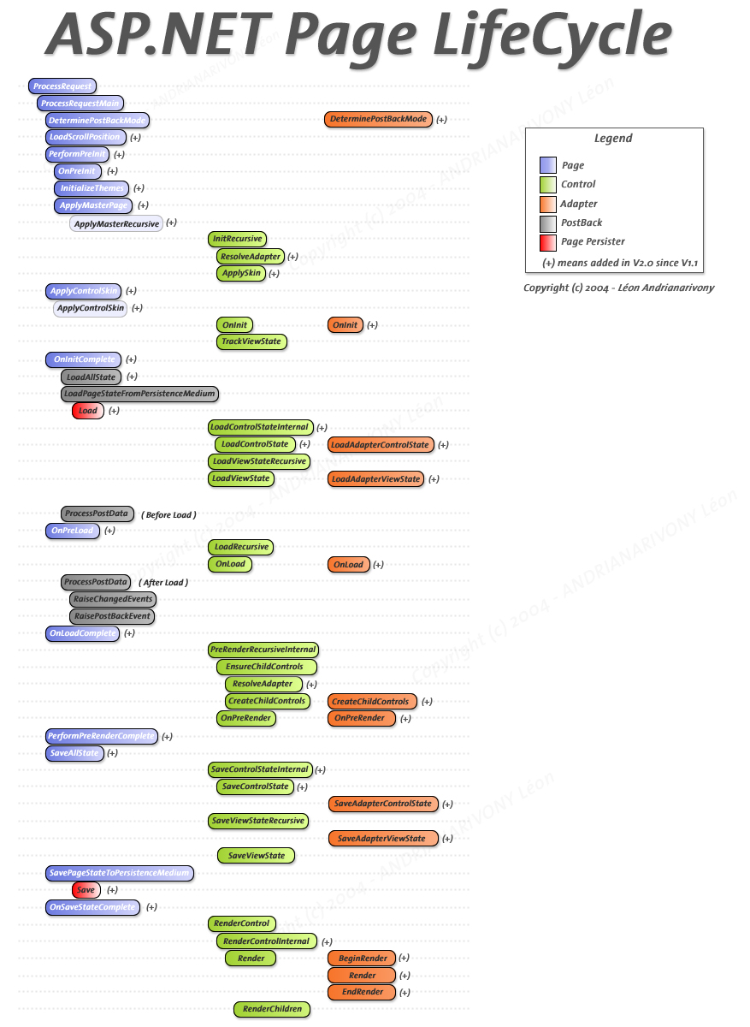

Slide 18
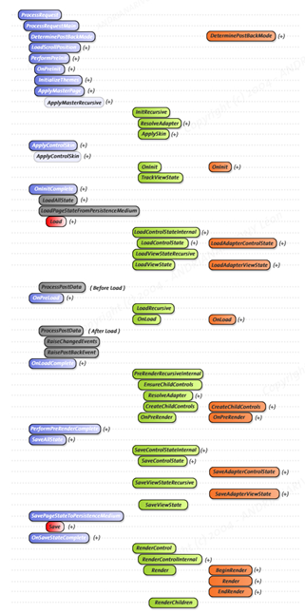
Default.aspx

Slide 19
Site.master
Products.aspx
Cart.ascx

Slide 20
Default.aspx
Products.aspx
About.aspx

Slide 21
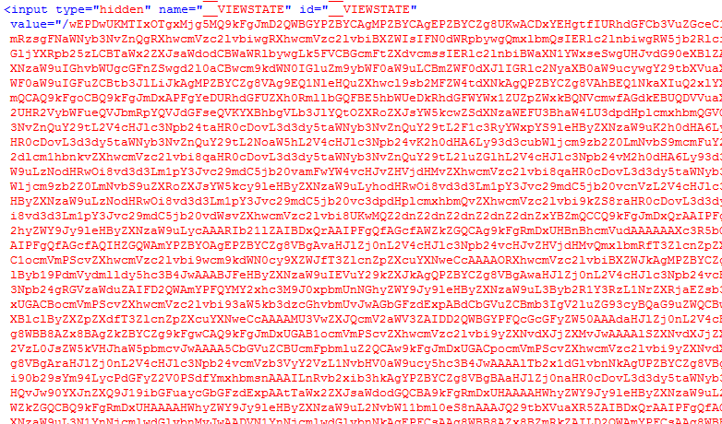
Viewstate

Slide 22
<select name="ctl00$uxLanguageSelector$uxLanguageSelector" onchange="javascript:setTimeout('__doPostBack(\'ctl00$uxLanguageSelector$uxLanguageSelector\',\'\')', 0)" id="ctl00_uxLanguageSelector_uxLanguageSelector" class="countrySelect">

Slide 23
Testability
Unit testing helps you change code with confidence
ASP.NET MVC is designed to make unit testing easy

Slide 24
Hello ASP.NET MVC
Notes:
Folders, moving parts

